Slide 1
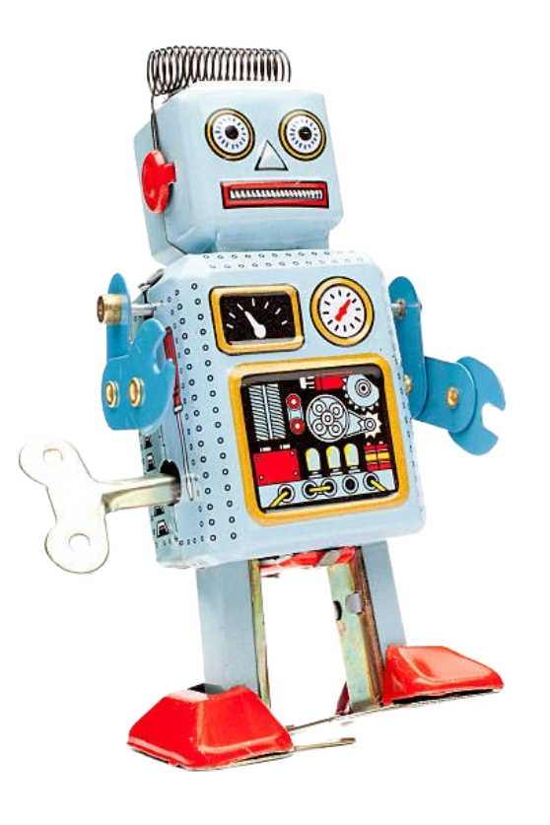
Team 19
NASA Lunabotics Competition
Ryan Cheng Joseph Folen Landon Reynolds Maxwell Thursby Blake Williams Kevin Zheng
Notes:
max

Slide 2
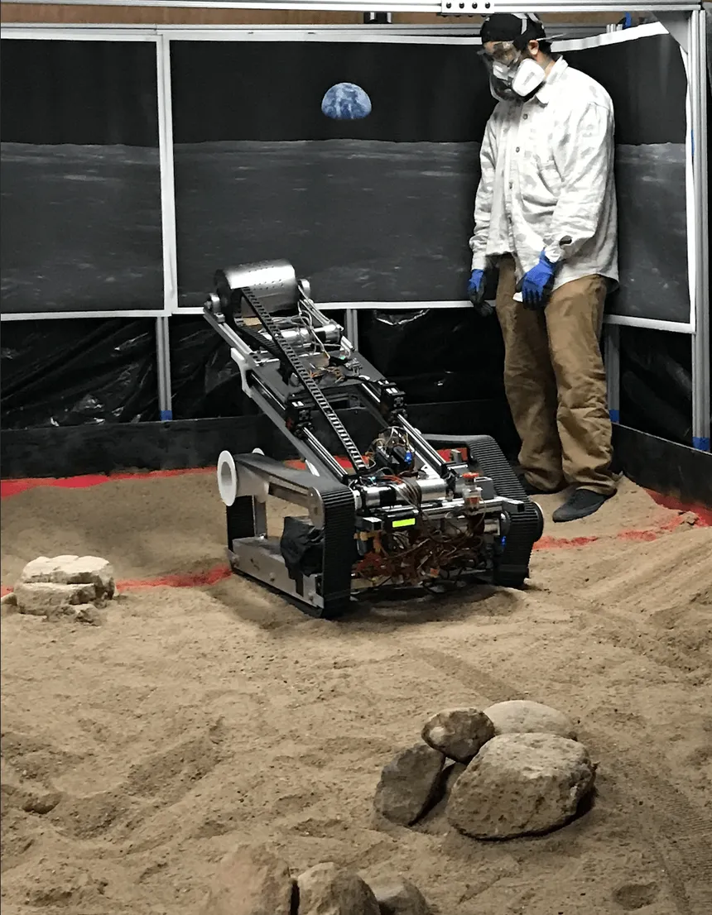
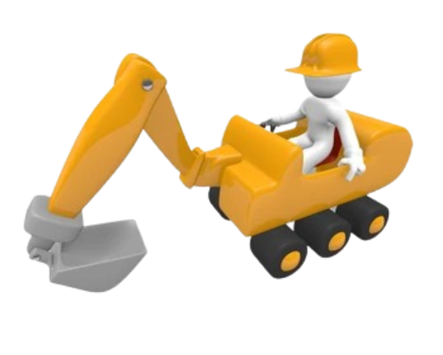
Abstract
With inspiration from the annual NASA Lunabotics Competition, we are working together with a team of mechanical engineers to produce a new rover from the ground up
Our goal for this project is to improve the software and prepare the robot for competition by the end of the year with testing happening throughout next semester
Notes:
max

Slide 3

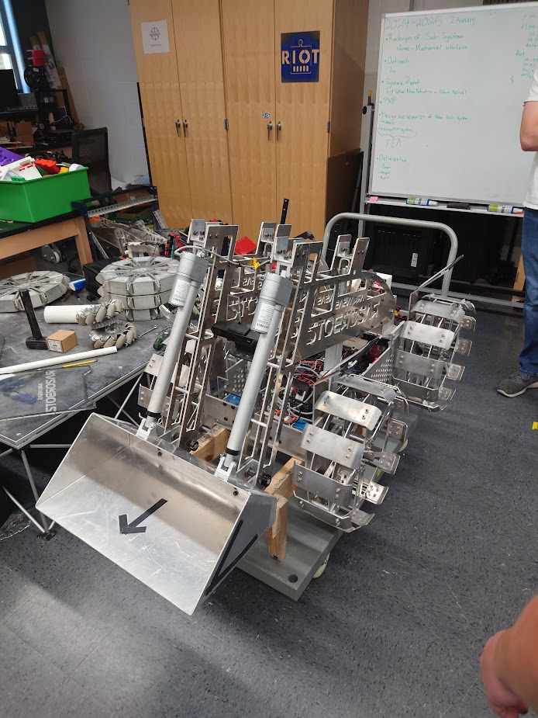
Problem
Unreliable communication system
Electromagnetic interference
Cumbersome robot testing
Unsatisfactory GUI
No additional cameras for arena awareness
heavy
Notes:
kevin

Slide 4
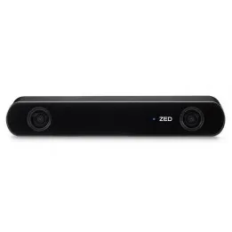
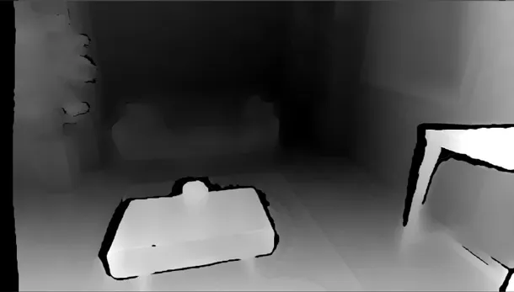
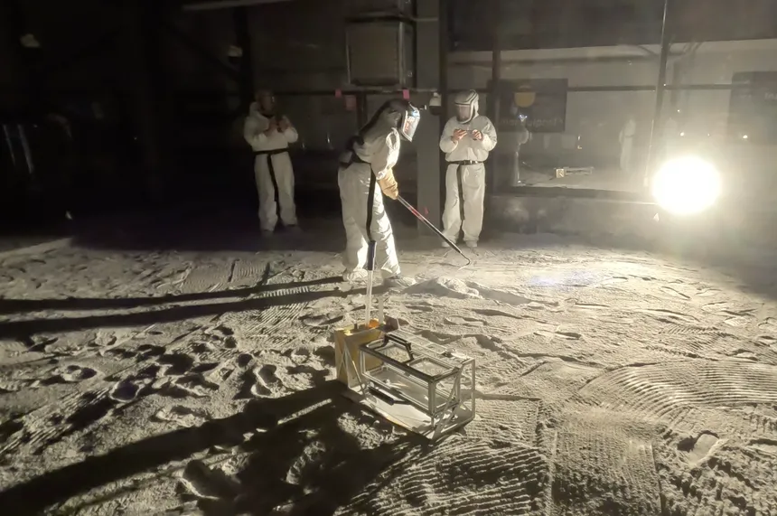
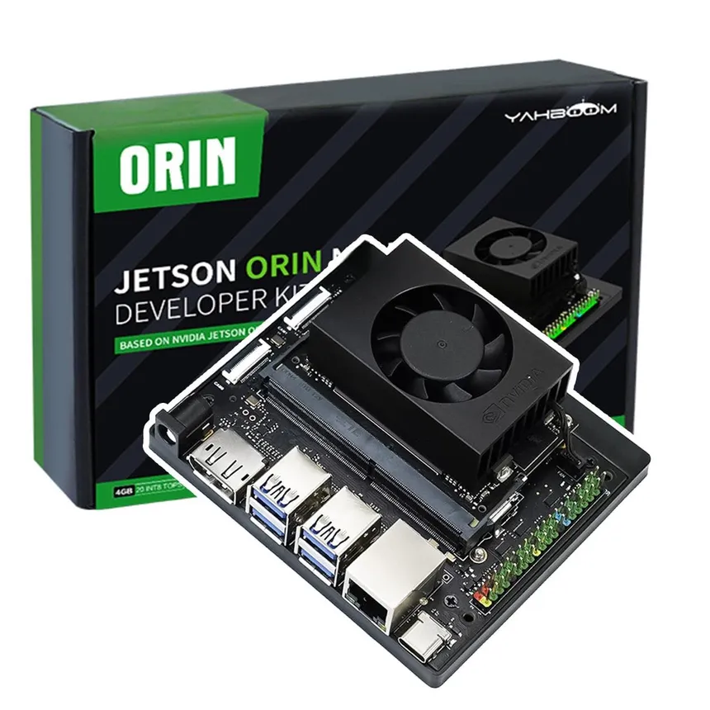
Background
Key Concepts
BP-1 (Simulant), ROS2 Galactic, Jetson Orin Nano, CAN Bus, Gazebo, GTKMM, ZED API, UDP
Related Work
Previous years’ robots
Skinny
Spinner
Scoop
Shovel
Notes:
landon

Slide 5
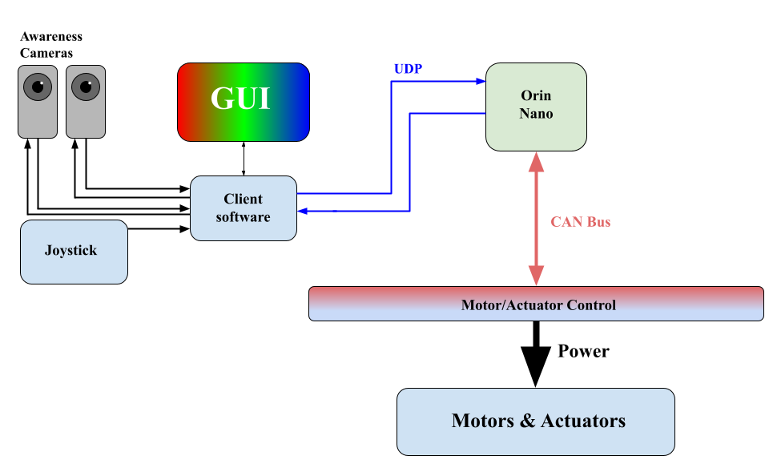
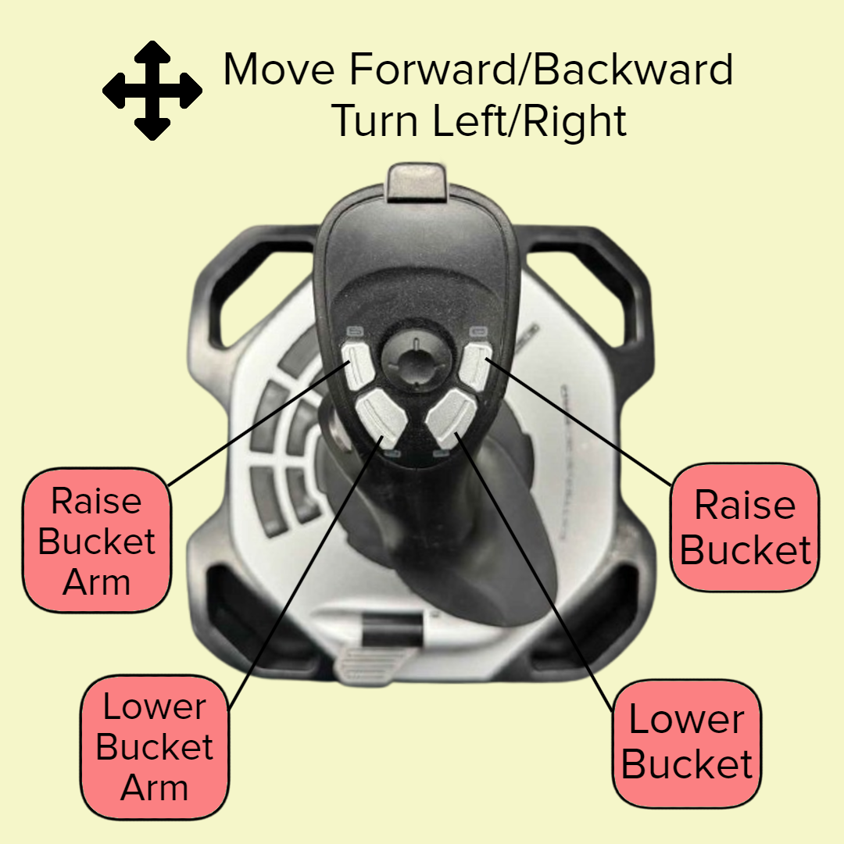

Use Cases
Fully autonomous but can be controlled (WiFi)
Camera feed for navigation
Driver can take control using the joystick
Notes:
josef

Slide 6

Requirements
Robot dimensions, maximum mass, and navigation
The robot should be autonomous to help gain extra points
The robot needs to have a bucket to pick up piles of dirt
The robot must avoid any obstacles during testing and the competition
Joystick that allows basic driving controls and bucket movement
Runtime requirement that the robot must achieve during the competition and testing
Notes:
ryan probably

Slide 7


Schedule
Simulation Group Timeline
Understand the simulation software - 1 wk
Get UARK testbed measurement and development - 2 wk
UCF and NASA testbed development - 6 wk
Camera Bandwidth/Reliability Group Timeline
ROS2 documentation and tutorials overview - 6 wk
New protocols and revise networking code - 6 wk
Testing and Refactor Networking Code - 4 wk
Graphic User Interface Group Timeline
GTKMM documentation overview - 1 wk
Current GUI modifications - 2 wk
Motor and primary camera GUI implementation - 2 wk
Back up camera, arena camera, and mini map GUI implementation - 6 wk
Notes:
blake

Slide 8

Sources
Razorbotz. (2024). communication_node.cpp.
https://github.com/Razorbotz/ROS2/blob/master/shovel/src/communication/src/communication_node.cpp
Open Robotics. (2024). ROS 2 Documentation.
https://docs.ros.org/en/galactic/index.html
Open Robotics. (2024). Simulation.
https://docs.ros.org/en/galactic/Tutorials/Advanced/ Simulators/Simulation-Main.html

